Slide 1
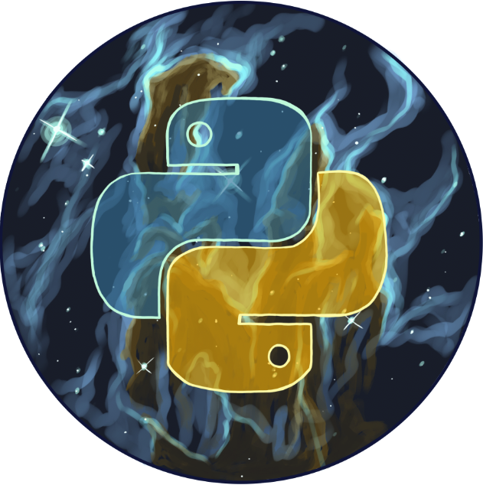

Welcome to the
Python DeCal!
Lecture: Animation
[Class 23] November 17th, 2025

Slide 2
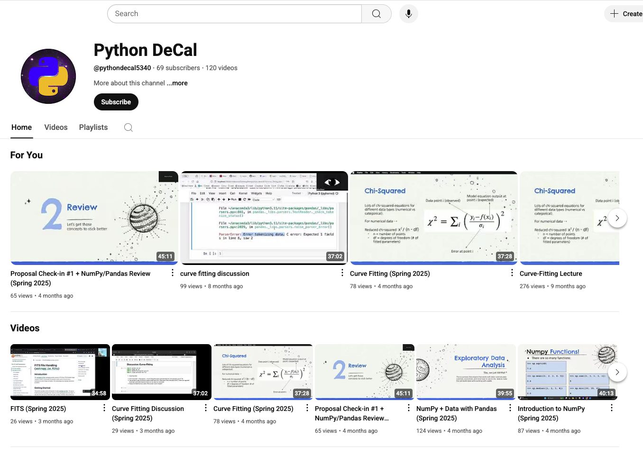
Lectures will be Recorded
This class will be recorded and posted to our YouTube Channel!
Subscribe :)

Slide 3
Overview for today!
Announcements
Warm-up
Demo
  Animation
Lecture Engagement

Slide 4
01
Announcements
:) :) :) :) :) :) :) :) :) :) :) :)

Slide 5
Announcements
HW #11 is due this Wednesday, Nov. 19th at 11:59 PM
HW #12 was released today, Monday Nov. 17th
HW #12 is due next, next Wednesday, Dec 3rd at 11:59 PM
Check-in #2 is due this Wednesday, Nov 19th at 11:59 PM
Final Project, Presentation and Report are due next, next, Monday, Dec. 1st, 3:59 PM

Slide 6
02
Warm-Up
Let’s do a little review

Slide 7
Warm-up questions
Please write your answers on a piece of paper:
Name one type of documentation.
How would you change the readability of the following function:
def func(x):
if num % 3 == 0: #check if a number is divisible by 3
return True
else:
Return False

Slide 8
Answers to Questions
Inline comments, doc strings, top-level docs like a README
I would remove the inline comment and change the function name to be more descriptive.

Slide 9
03
Lecture
A brief overview of the structure.

Slide 10
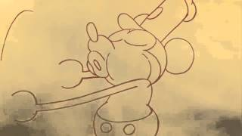
What is animation?

Slide 11
What is animation?
We take a set of images, flip through them and stitch them together into an MP4 file.
What kind of object can show visual data that we can update over and over again?

Slide 12
Structure of an animation (naively)
Initialize a Figure object
Iterate through a time axis (generally time steps, i.e. a list from 0 to 10 seconds)
Update the data as it should behave as time goes on, overwrite plot on the figure.
Save them with a handy-dandy matplotlib function.

Slide 13
Structure of an animation (based on FuncAnimation)
Initialize a Figure object and a line object.
Define a function that defines the behavior as time goes on in the gif.
Feed it some sort of iterable that defines time progression.
Use a handy-dandy Python function to stitch the figures together (but under the hood).

Slide 14
03
Demo:
Matplotlib Funcanimation

Slide 15
Matplotlib Funcanimation
Imports:
import matplotlib.pyplot as plt
import numpy as np
from matplotlib.animation import FuncAnimation
Extra: Use %matplotlib inline or %matplotlib notebook to
view your animation inside Jupyter Notebook!

Slide 16
Let’s Make a Sine Wave!
Create a figure and function:
fig, ax = plt.subplots()
x = np.linspace(0,2*np.pi, 100)
def func(x):
return np.sin(x)
Initialize a Line Object
line, = ax.plot(x, func, lw = 2)

Slide 17
Let’s Make a Sine Wave!
Update the Figure
def update(frame):
line.set_ydata(np.sin(x + frame / 20)
return line,
Piece it Together:
anim = FuncAnimation(fig, update, frames = 100,
interval = 50, blit = True)

Slide 18
Let’s Make a Sine Wave!
If you used %matplotlib, you should be able to view your animation after running the cell. If not, no worries! We can just save our animation.

Slide 19
Saving an Animation
Edit your import:
from matplotlib.animation import FuncAnimation, PillowWriter
Saving:
writer = PillowWriter(fps = 10)
anim.save(“sine_wave.gif”, writer = writer)

Slide 20
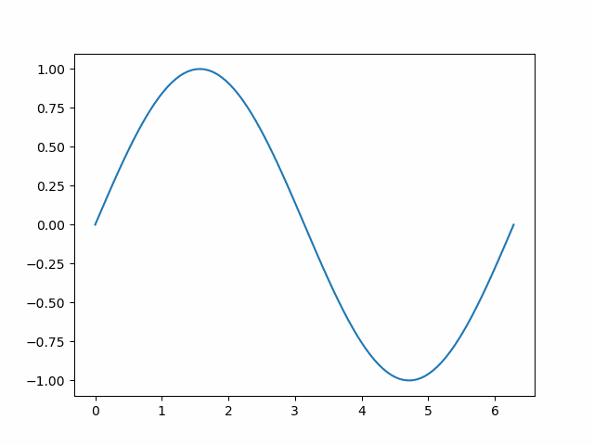
Result

Slide 21
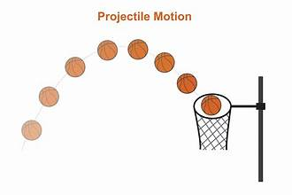
Projectile Motion
Let’s try to model the vertical height of an object being thrown!

Slide 22
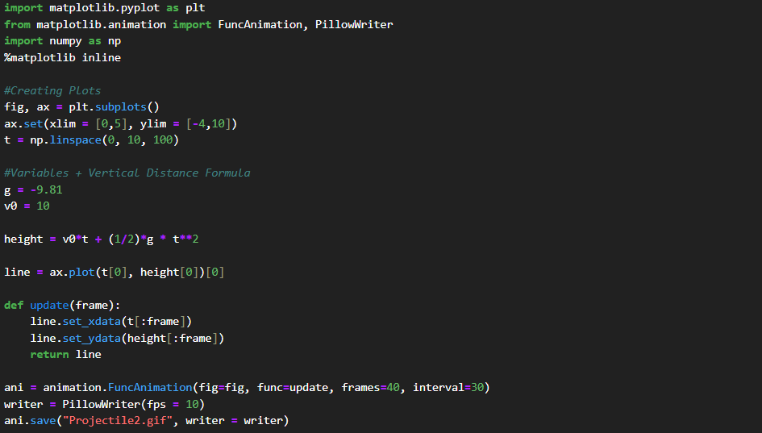
Projectile Motion

Slide 23
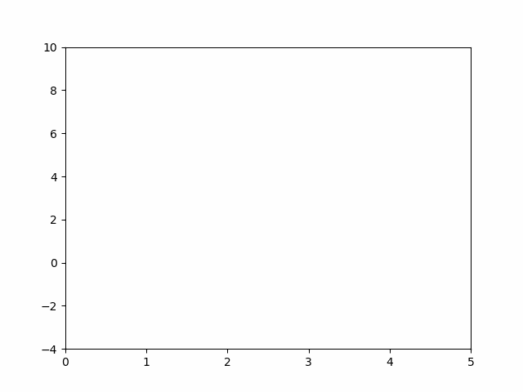
Result

Slide 24
Try Your Own!
Pick a function to animate and spend the rest of class trying to bring it to life!

Slide 25
04
Lecture Engagement
Show us what you know!

Slide 26
Lecture Engagement
Fill out the engagement assignment on Gradescope!
Always due before next class.
Takes 1-5 minutes to complete.

